Slide 1
Job Roles, Salary, & Attrition
Rachel Liercke

Slide 2
AGENDA
Introduction​
Job Trends
Monthly Income Predictors
Attrition Predictors
​Summary​

Slide 3
Introduction
DDSAnalytics has been tasked with:
Finding Job Role Trends
Predicting Monthly Income
Predicting Attrition
Relaying any other important information

Slide 4
Job role trends

Slide 5
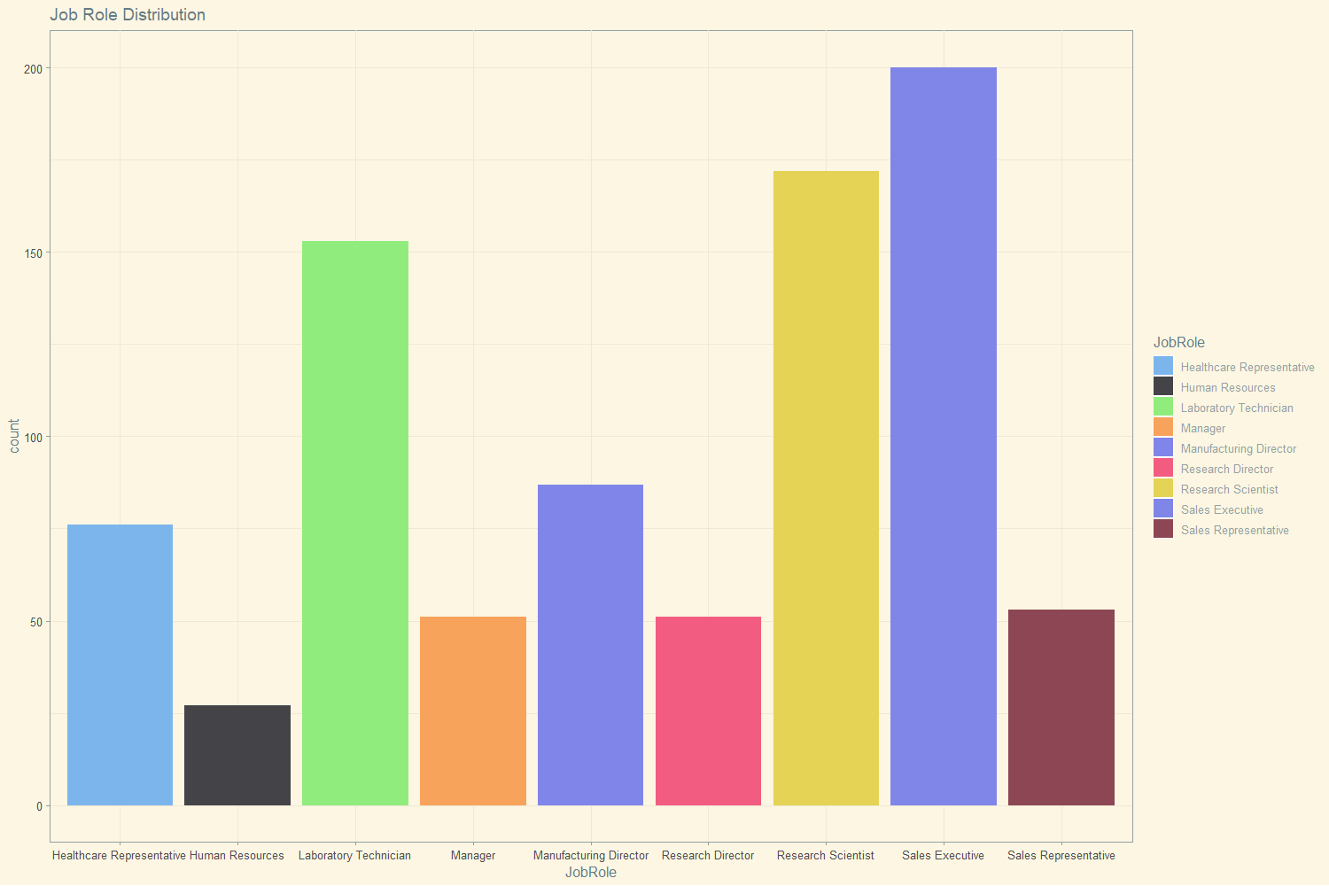
Job Role distribution

Slide 6
Major factors
Factors with the most significant influence on Job Role:
Department
Job Level
Monthly Income
Factors with the significate influence on Job Role:
Education
Over Time
Training Times Last Month

Slide 7
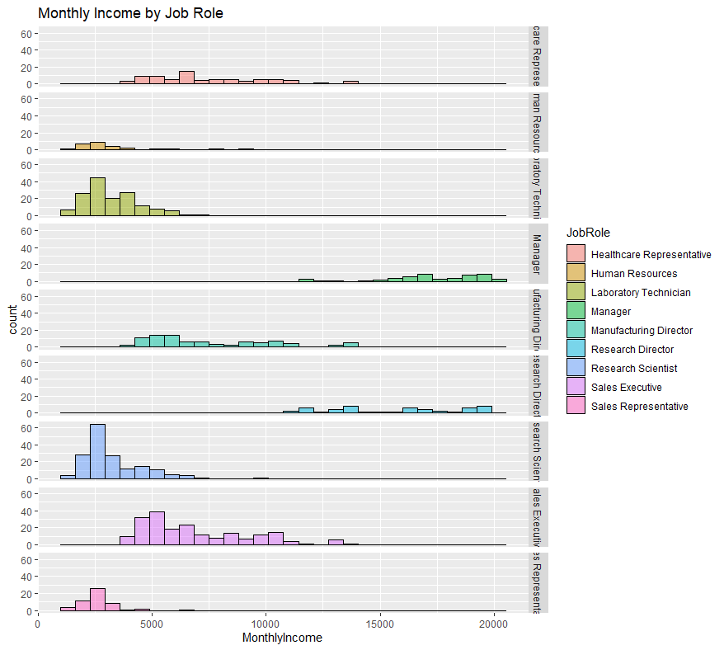
Visual look- monthly income
Notes:
Did not include job level or department because those are directly associated with job role. Income might be but this gives us a look at which roles are highest paid

Slide 8
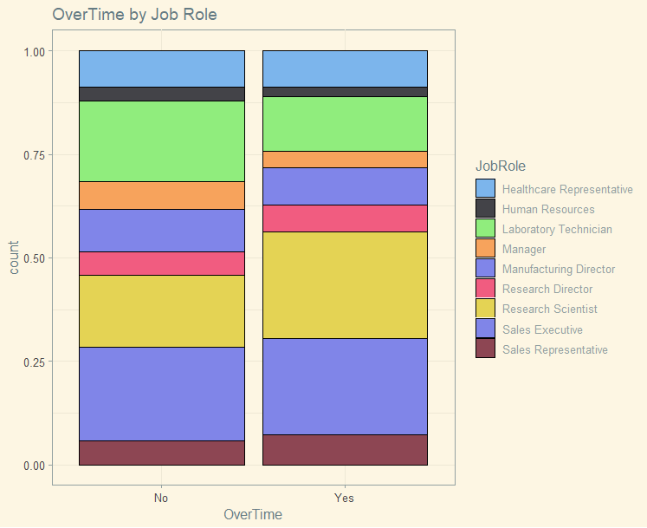
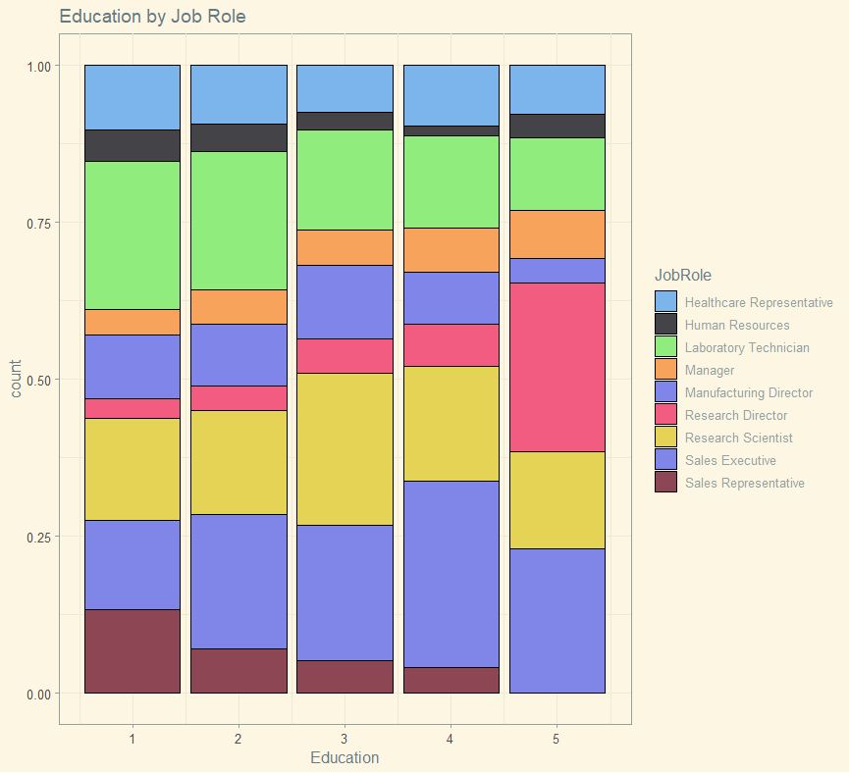
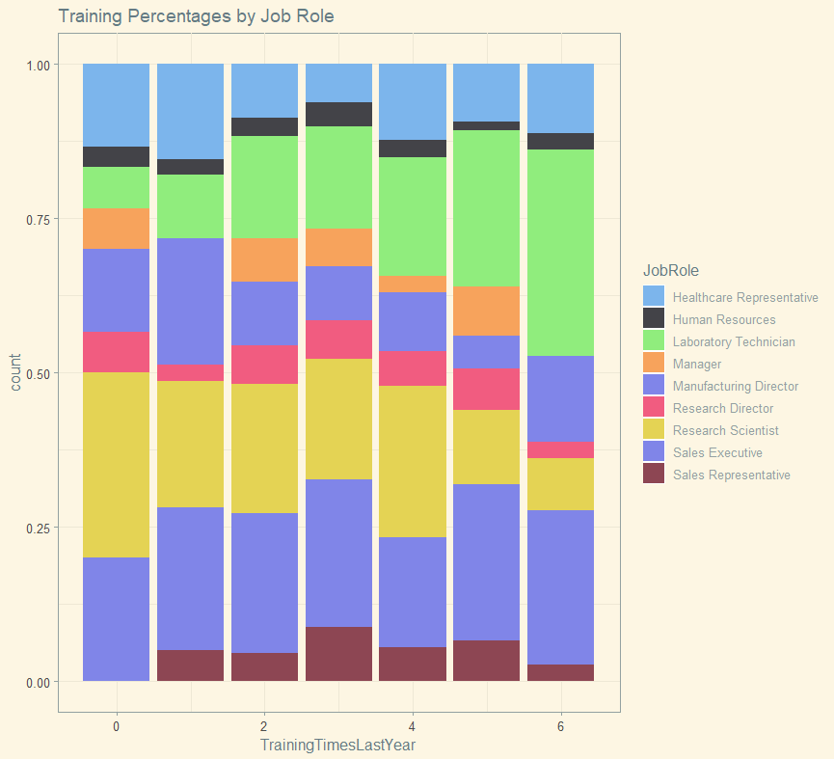
Significant factors
Notes:
Overtime

Slide 9
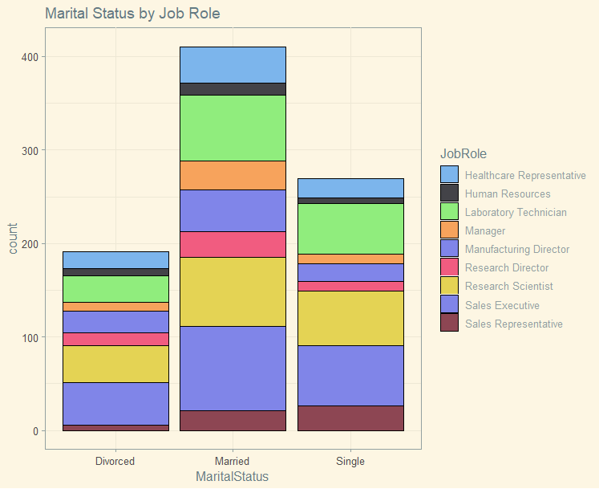
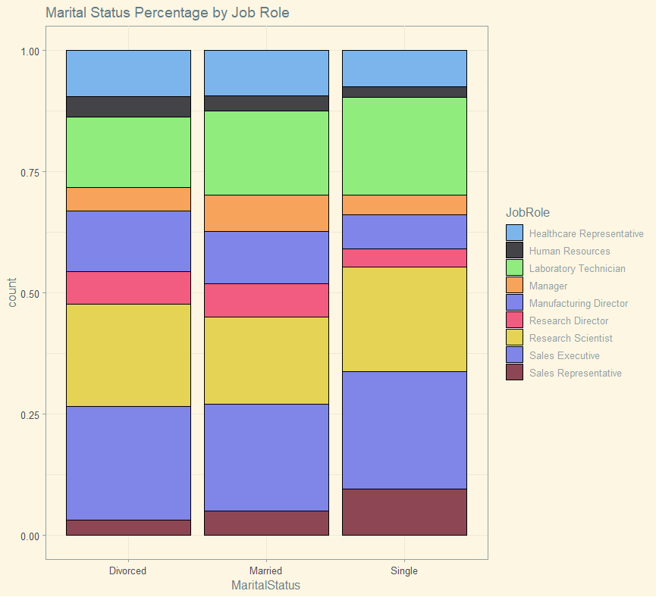
Noteworthy factors
Marital Status

Slide 10
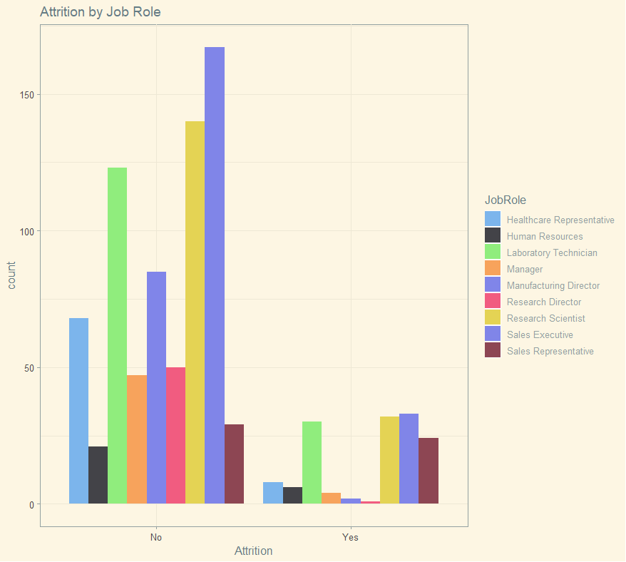
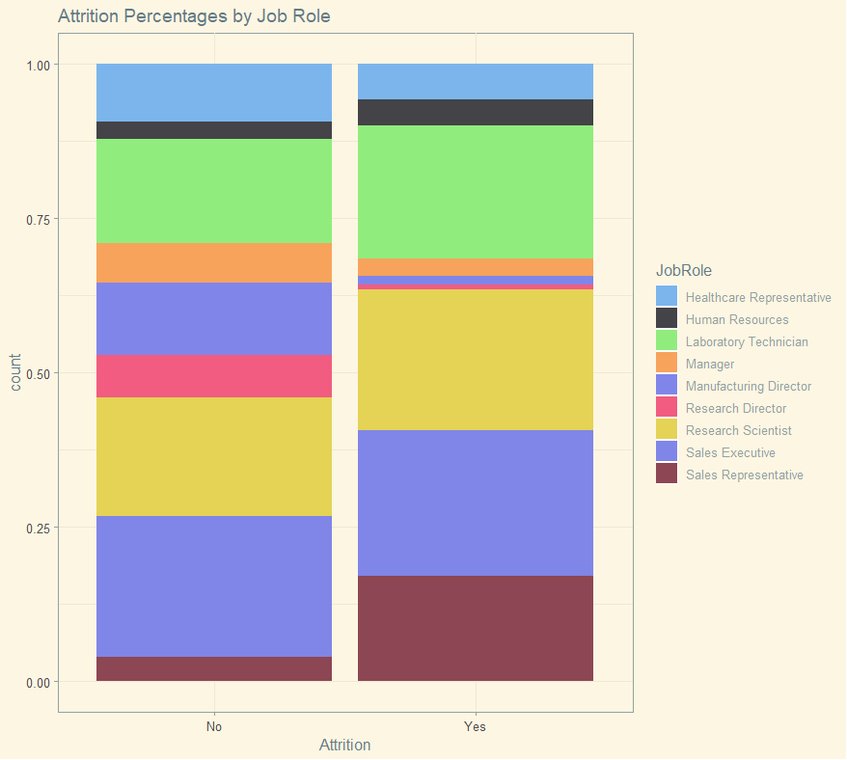
Noteworthy factors (cont.)
Attrition

Slide 11
Monthly Income

Slide 12
We have been tasked with predicting the Monthly Income of a group of people given multiple variables about a person’s job. Our goal was to run an analysis and use the most significant factors that influence the monthly income.

Slide 13
Monthly income Predictors
Running a linear regression model on all factors, the most significant are:
Business Travel
Department
Distance From Home
Environment Satisfaction
Job Level
Job Role
Total Working Years
Years With Current Manager

Slide 14
Monthly income (cont.)
Running this model a few times, we were able to narrow down the most significant factors to:
Department
Job Level
Total Working Years
Years with Current Manager
Using this model, we have provided a dataset with Monthly Income predictions that fit the requirements of RMSE <$3000.

Slide 15
attrition

Slide 16



Top attrition factors
Job satisfaction
marital status
Over Time

Slide 17
models
Linear Regression
Knn
Naïve Bayes
Not a good option for specificity and sensitivity
Second best choice
Best model had 45% for specificity
Best model
Had over 60% for both specificity and sensitivity

Slide 18
Final model
Factors included
Naïve Bayes Model
Age
Department
Distance
Environment
Job Involvement
Job Satisfaction
Marital Status
Number Companies worked for
Over Time
Work Life Balance
Years in Current Role
Years Since Last Promotion
Years with Current Manager
Naïve Bayes gave us the best accuracy to predict attrition. We feel comfortable saying these are the best factors for this and future datasets.

Slide 19
Questions?

Slide 20
THANK YOU
Rachel Liercke
rliercke@mail.smu.edu
Rachel.Liercke@gmail.com
https://youtu.be/T95nIE4KxRA
Job Roles (shinyapps.io)

